Slide 1
Supervisor: Dr. LCM Student: YIN, Zhendong
MATH 4999 Regular Meeting I

Slide 2
Report on the progress
1
Progress of my reading and learning
2
Progress of my data collecting
3
Progress of the programming learning
4
Conception & ideas of the project
5
Questions and problems

Slide 3
Progress of my reading and learning
Books:
For this book, I start from Chapter 3: Basic Investment Models and Their Statistical Analysis;
1. CAPM Model(Review)
2. Multifactor pricing models: APT, PCA Approach, Fama-French three-factor model
3. Application: Michaud’s resampled efficient frontier, Bootstrap
Also learned Chapter 4: Parametric Models and Bayesian Methods;
1. MLE & GLM
2. Bayesian inference: Prior and posterior, empirical Bayes and shrinkage estimators
3. Application: Shrinkage estimators, plug-in
Go deep in Chapter 5&6: Time Series Modeling and Forecasting
1. Stationarity: From stationary time series to nonstationary time series analysis
2. Model: AR, MA, ARMA, ARIMA, SARIMA, ARCH, GARCH and their application
Topics haven’t explored deeply yet:
The ARMA-GARCH and ARMA-EGARCH models and its application
Linear state-space models and Kalman filtering

Slide 4











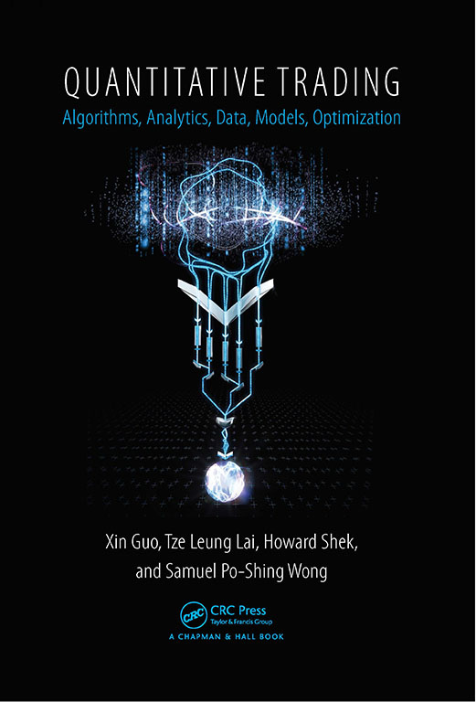
Progress of my reading and learning
Books:
For this book, I regard it as a supplementary reference book of the previous one, since it focuses on the model application on a larger range of finance industry. And I’m reading the chapter 2
In the chapter 2, it discusses deep into the stochastic process, NPEB and time series model, and the relationship, links between those topics and their combination application.
There’re also some new materials I’ve learnt in this book that I could use in my project, such as the normal QQ analysis and some historic models.
This books mainly focus on the time series and it goes deep into the topic.
I’ve also started to read this book, but the progress is slow, since I had to refer to more materials to understand the ideas, logic or even notations.

Slide 5

Progress of my reading and learning
Course:
This course focuses on the application of math in finance.
While there are several chapters talking and illustrating time series. And it also provides real case analysis.
My progress in this course on time series topics is halfway through.
And haven’t reached to case studies.
I’m planning to finish this course before the end of this month.
https://ocw.mit.edu/courses/mathematics/18-s096-topics-in-mathematics-with-applications-in-finance-fall-2013/index.htm
5

Slide 6
Progress of my data collecting
Totally 50 stocks listed in HIS, whose datas includes volumes, daily price, daily return.
Range: 2009.1.2-2019.12.31
股份代號 | 名稱 | 流通系數（%） | 比重（%）
HSI | 恆指成份股
HSF | 金融分類
01299 | 友邦保險 | 100 | 9.95
00005 | 滙豐控股 | 100 | 7.68
00939 | 建設銀行（H） | 45 | 6.33
02318 | 中國平安（H） | 80 | 4.88
00388 | 香港交易所 | 95 | 4.16
01398 | 工商銀行（H） | 85 | 3.41
03988 | 中國銀行（H） | 95 | 2.12
02628 | 中國人壽（H） | 100 | 1.28
00011 | 恒生銀行 | 40 | 0.98
02388 | 中銀香港 | 35 | 0.87
03328 | 交通銀行（H） | 25 | 0.36
共 |  |  | 42.00%
HSU | 公用事業分類
00002 | 中電控股 | 80 | 1.43
00003 | 香港中華煤氣 | 60 | 1.21
00006 | 電能實業 | 65 | 0.55
01038 | 長江基建集團 | 30 | 0.30
共 |  |  | 3.50%
HSP | 地產分類
00823 | 領展房產基金 | 100 | 1.35
00016 | 新鴻基地產 | 40 | 1.18
01109 | 華潤置地 | 45 | 1.17
01113 | 長實集團 | 70 | 1.04
02007 | 碧桂園 | 35 | 0.82
00688 | 中國海外發展 | 35 | 0.79
01997 | 九龍倉置業 | 55 | 0.60
00017 | 新世界發展 | 60 | 0.59
00012 | 恒基地產 | 30 | 0.43
00101 | 恒隆地產 | 45 | 0.40
共 |  |  | 8.37%
股份代號 | 名稱 | 流通系數（%） | 比重（%）
HSC | 工商業分類
00700 | 騰訊控股 | 65 | 10.00
09988 | 阿里巴巴(SW) | 65 | 5.00
03690 | 美團點評(W) | 65 | 5.00
01810 | 小米集團(W) | 65 | 3.32
00941 | 中國移動 | 30 | 3.13
02269 | 藥明生物 | 80 | 2.20
00883 | 中國海洋石油 | 40 | 1.49
00669 | 創科實業 | 85 | 1.43
00001 | 長和 | 70 | 1.39
00027 | 銀河娛樂 | 50 | 1.22
00175 | 吉利汽車 | 60 | 1.07
02319 | 蒙牛乳業 | 70 | 1.05
02313 | 申洲國際 | 55 | 1.04
02020 | 安踏體育 | 40 | 0.99
02382 | 舜宇光學科技 | 65 | 0.98
01928 | 金沙中國有限公司 | 35 | 0.89
01177 | 中國生物製藥 | 60 | 0.85
00386 | 中國石油化工股份（H） | 95 | 0.84
01093 | 石藥集團 | 75 | 0.69
00066 | 港鐵公司 | 25 | 0.61
00288 | 萬洲國際 | 55 | 0.51
00857 | 中國石油股份（H） | 100 | 0.50
01876 | 百威亞太 | 15 | 0.46
00267 | 中信股份 | 25 | 0.45
01044 | 恆安國際 | 60 | 0.38
00762 | 中國聯通 | 20 | 0.32
02018 | 瑞聲科技 | 60 | 0.30
共 |  |  | 46.12%
總/ |  |  | 100%
Stocks that I need to supplement:
6
6

Slide 7
Progress of the program learning
Analysis tools that I decide to use:
Python and R
Use these tools to conduct time series analysis: find ACF, PACF to fit the chosen model on different stock
7
7

Slide 8
Conception & ideas of the project
Step 1: collect enough and effective data
Step 2: try to fit appropriate time series models to different stocks
Step 3: optimize the models by testing and checking
Step 4: picking out and synthesize the best portfolio(based on some specific criteria)
8
8
8

Slide 9
Questions and problems
Is my conception in the appropriate direction or shall I go deeper?
How much data is adequate and what data is effective?
Shall I fit all stocks with models, is there any way to optimize?
Advice for the programming and illustration style
My worry: there seems few new and creative ideas or thinking that I propose by now
To do that, I shall work on model optimization or programming algorithm
1.Focus on single stock
Pick appropriate models
Learn from other application and cases to understand factors adopted
Test the fitness of the model
Methodology
Select the best model on single stock(learn the criteria)
Collect information
Data range(5 years) as much as possible
9
9

Slide 10
Supervisor: Dr. LCM Student: YIN, Zhendong
MATH 4999 Regular Meeting II

Slide 11
Report on the progress
1
Progress of my reading and learning
2
Data collection and examination
Detailed model construction idea & algorithm
3
4
Modeling example
5
Questions and problems

Slide 12
Progress of my reading and learning
Books:
1. Reach to Chapter 6: Dynamic models of asset returns and their volatility
This chapter focuses on discussion on the asset volatility.
Apart from forecasting the asset return, the estimation and valuation of the asset volatility is crucial when constructing the best forecasting model and portfolio
2. Go deep into the topics
The detailed modelling strategies, testing strategies, criteria
Algorithm learning
Invest large amount of time on the programming learning
Use both python and R
Some discovery of the better algo

Slide 13
Data collection and handling
Totally 50 stocks listed in HIS, whose data includes volumes, daily price, daily return.
Range: 2009.1.2-2019.12.31
40+ stocks has historical data of more than 2000 trading days.
Basically all the companies have around 1mln-20mln daily trading volume, which is sufficient for the forecasting. Some new technology companies, such as Meituan, jingdong, xiaomi have roughly 500-1000 trading days data, which can be referred.
There exists volatility clustering problems in data, to solve that, according to the chapter 6, I try to figure out the characters of the data and use different tests to examine on the stationarity, volatility to fit the best model
股份代號 | 名稱 | 流通系數（%） | 比重（%）
HSI | 恆指成份股
HSF | 金融分類
01299 | 友邦保險 | 100 | 9.95
00005 | 滙豐控股 | 100 | 7.68
00939 | 建設銀行（H） | 45 | 6.33
02318 | 中國平安（H） | 80 | 4.88
00388 | 香港交易所 | 95 | 4.16
01398 | 工商銀行（H） | 85 | 3.41
03988 | 中國銀行（H） | 95 | 2.12
02628 | 中國人壽（H） | 100 | 1.28
00011 | 恒生銀行 | 40 | 0.98
02388 | 中銀香港 | 35 | 0.87
03328 | 交通銀行（H） | 25 | 0.36
共 |  |  | 42.00%
HSU | 公用事業分類
00002 | 中電控股 | 80 | 1.43
00003 | 香港中華煤氣 | 60 | 1.21
00006 | 電能實業 | 65 | 0.55
01038 | 長江基建集團 | 30 | 0.30
共 |  |  | 3.50%
HSP | 地產分類
00823 | 領展房產基金 | 100 | 1.35
00016 | 新鴻基地產 | 40 | 1.18
01109 | 華潤置地 | 45 | 1.17
01113 | 長實集團 | 70 | 1.04
02007 | 碧桂園 | 35 | 0.82
00688 | 中國海外發展 | 35 | 0.79
01997 | 九龍倉置業 | 55 | 0.60
00017 | 新世界發展 | 60 | 0.59
00012 | 恒基地產 | 30 | 0.43
00101 | 恒隆地產 | 45 | 0.40
共 |  |  | 8.37%
股份代號 | 名稱 | 流通系數（%） | 比重（%）
HSC | 工商業分類
00700 | 騰訊控股 | 65 | 10.00
09988 | 阿里巴巴(SW) | 65 | 5.00
03690 | 美團點評(W) | 65 | 5.00
01810 | 小米集團(W) | 65 | 3.32
00941 | 中國移動 | 30 | 3.13
02269 | 藥明生物 | 80 | 2.20
00883 | 中國海洋石油 | 40 | 1.49
00669 | 創科實業 | 85 | 1.43
00001 | 長和 | 70 | 1.39
00027 | 銀河娛樂 | 50 | 1.22
00175 | 吉利汽車 | 60 | 1.07
02319 | 蒙牛乳業 | 70 | 1.05
02313 | 申洲國際 | 55 | 1.04
02020 | 安踏體育 | 40 | 0.99
02382 | 舜宇光學科技 | 65 | 0.98
01928 | 金沙中國有限公司 | 35 | 0.89
01177 | 中國生物製藥 | 60 | 0.85
00386 | 中國石油化工股份（H） | 95 | 0.84
01093 | 石藥集團 | 75 | 0.69
00066 | 港鐵公司 | 25 | 0.61
00288 | 萬洲國際 | 55 | 0.51
00857 | 中國石油股份（H） | 100 | 0.50
01876 | 百威亞太 | 15 | 0.46
00267 | 中信股份 | 25 | 0.45
01044 | 恆安國際 | 60 | 0.38
00762 | 中國聯通 | 20 | 0.32
02018 | 瑞聲科技 | 60 | 0.30
共 |  |  | 46.12%
總/ |  |  | 100%
13
13

Slide 14
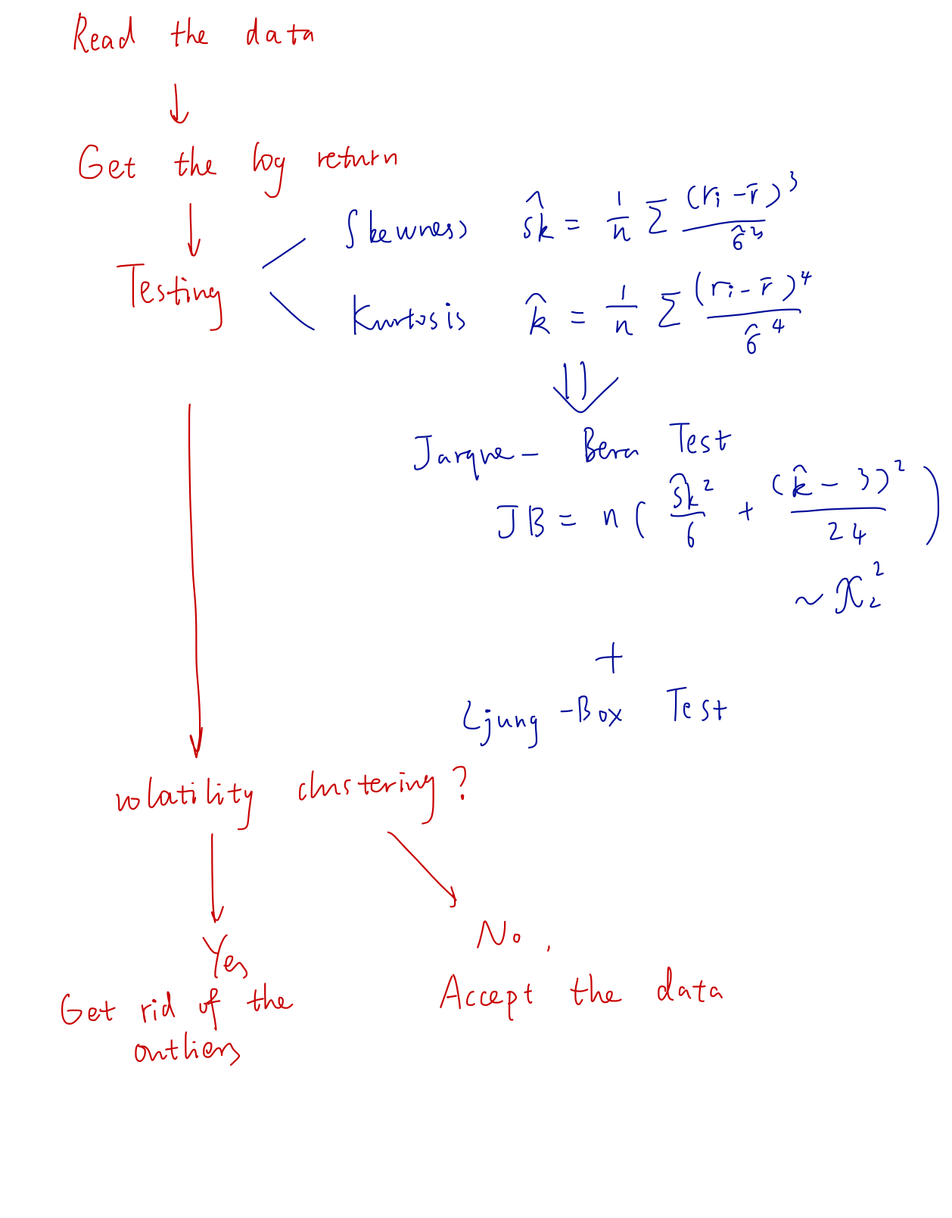
Data collection and handling
To optimize the data base I collect, I have the initial thought of handling of the stock price.
After the optimization of the data base, I should then go further into the volatility modeling.
14
14

Slide 15
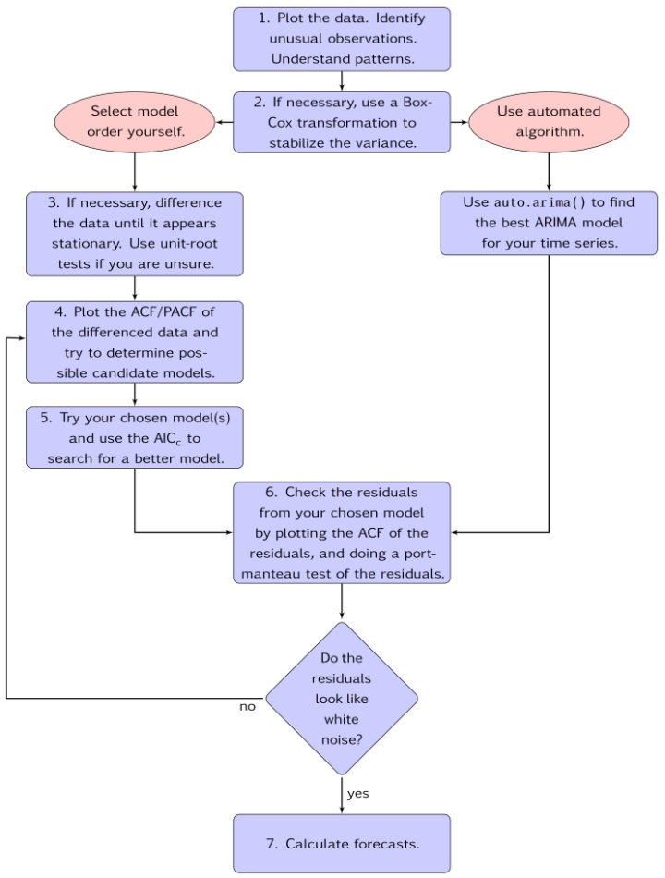
Detailed model construction idea & algorithm
Use python to construct the basic model.
However, the R has an automated package of fitting the best ARIMA model for the the series.
15
15

Slide 16
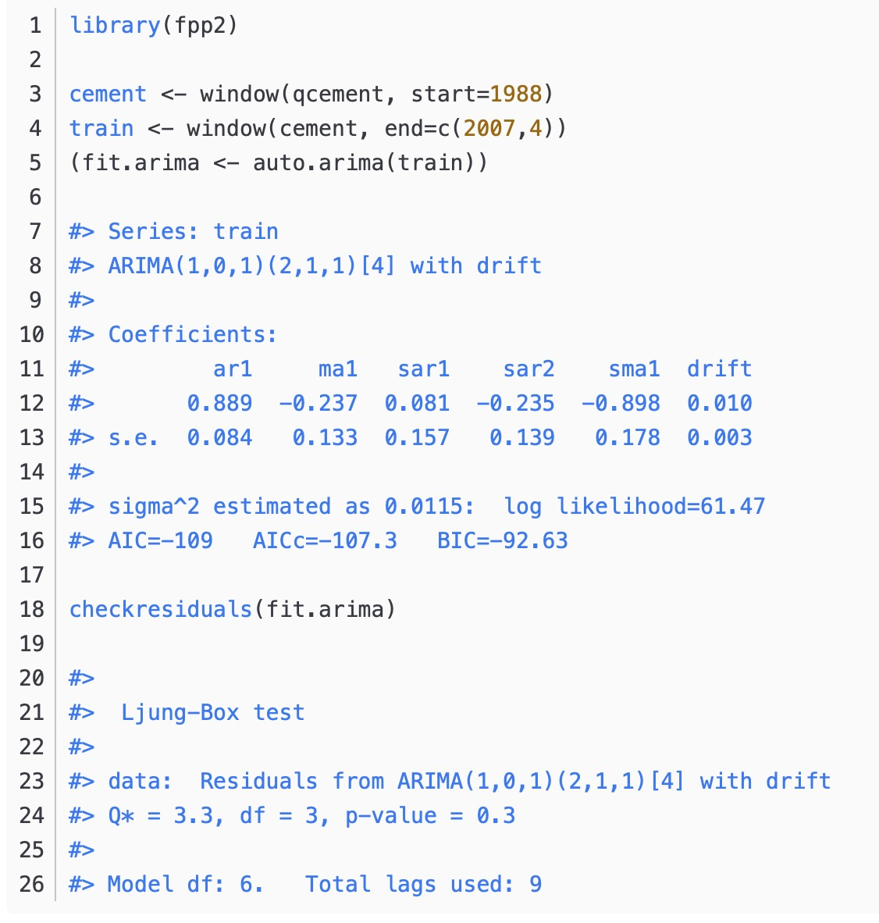
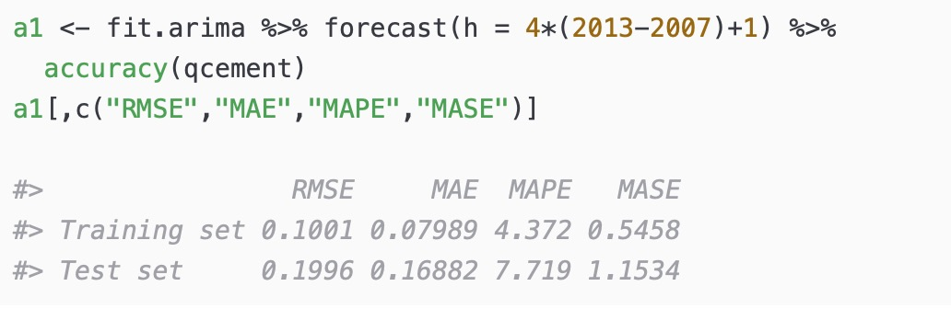
Detailed model construction idea & algorithm
Whether it is fitting, residual diagnosis, model prediction or effect evaluation, it is basically done in one step.
But currently, it seems that only package for ARIMA model is available on R.
16
16

Slide 17
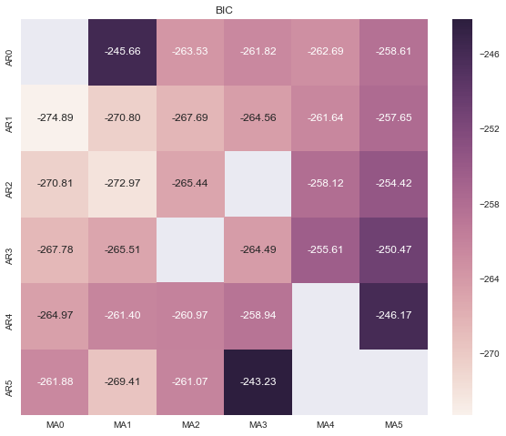
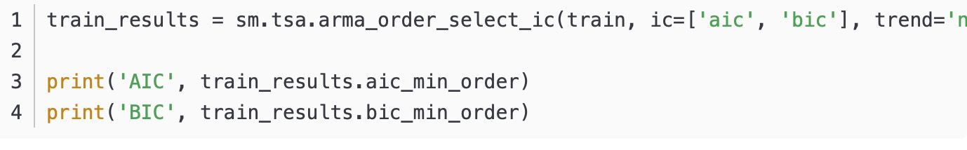
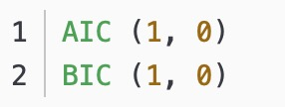
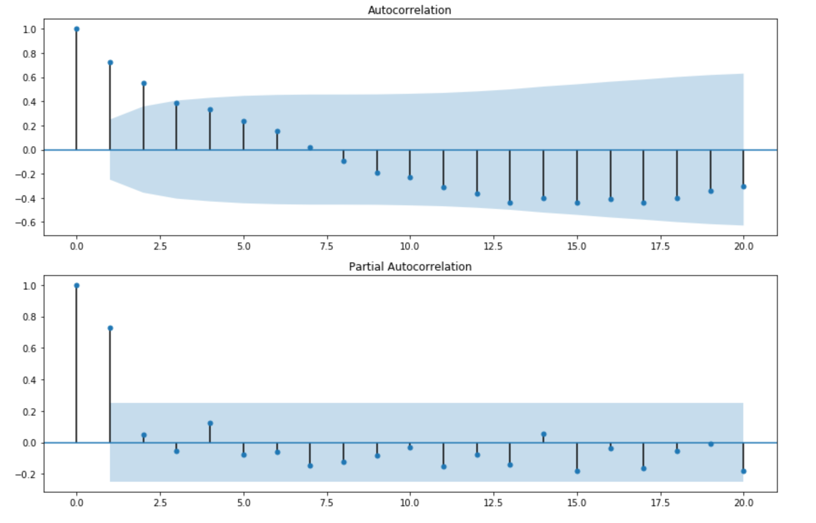
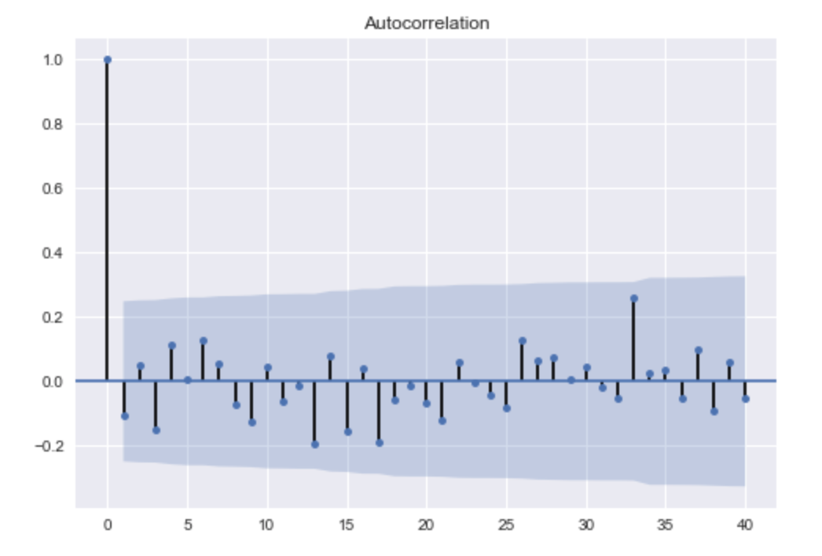
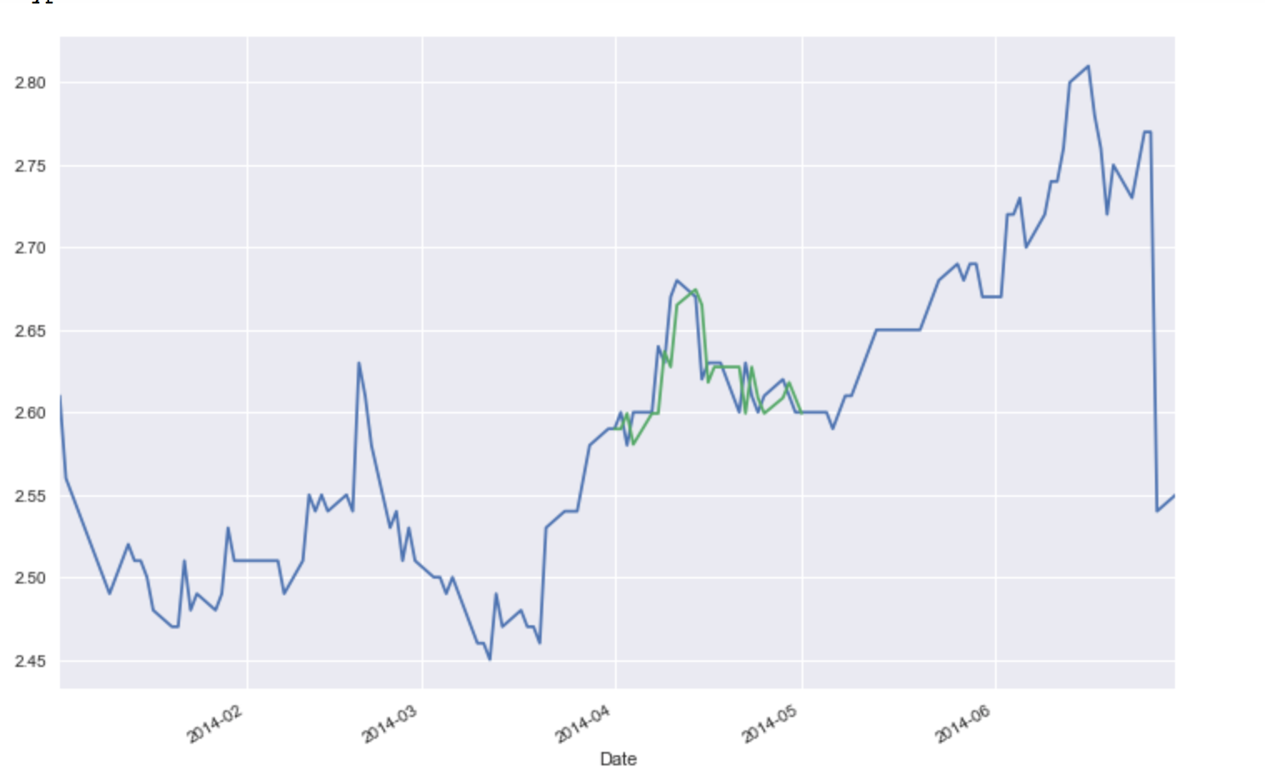
3. AIC & BIC to estimate
4. result: AR(1) model or ARIMA(1,0,0)
Modeling example
My first model is roughly constructed with python, data: chinabank
Time series stationarize (difference, log return)
Find ACF & PACF
5. Testing and forecasting
17
17

Slide 18
Questions and problems
Is my progress speed appropriate, shall I go faster?
To further optimize the data base, shall I grab stocks from other market?
Is my model example in the correct research direction?
Future arrangement(volatility modeling)
1.Detailed testing criteria list:
2.Objectives of the tests detailed explanation
3.Go deep into the idea discussion what are the purposes of the test
4.Research deep what I’ve learnt, the ideas and the logics
Improvement 34567steps
18
18

Slide 19
Supervisor: Dr. LCM Student: YIN, Zhendong
MATH 4999 Regular Meeting III

Slide 20
Report on the progress
1
Progress of my reading and learning
2
Detailed model construction idea part I
3
Questions and Reflections

Slide 21

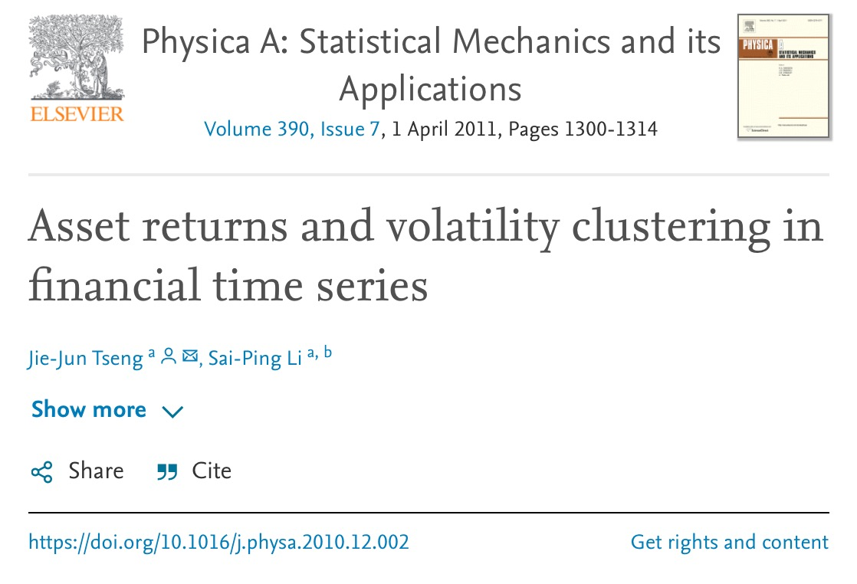
Progress of my reading and learning
Books & Paper:
Topics: volatility clustering and Box-Cox transformation
Reason: to observe the patterns of data, and by method of
transformation, to fit the normality in model optimization

Slide 22
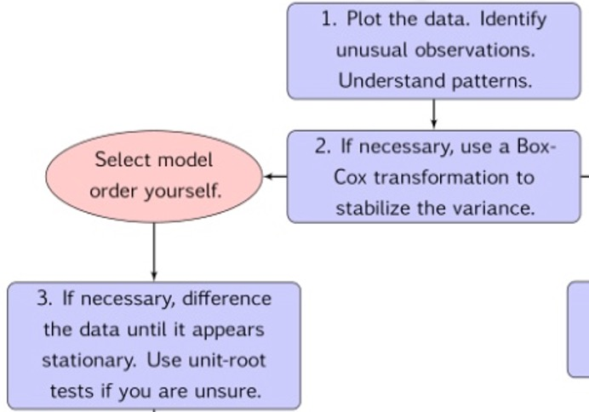
Detailed model construction idea part I
After having a comprehensive and basic knowledge of the project and model construction, I’m working on the detailed parts starting from the data.
Currently focus on the pattern observation, data transformation and volatility processing
Also learning the plotting algorithm, lol
RStudio
After transforming the data using Box cox, how we furtherly work on the data
Check on the distribution
22
22

Slide 23
Questions and Reflections
Reading should not be superficial, instead I should go deeper to understand but only the concept but also the logic and reason why it would be invented. While the more reading, the better understanding.
Should develop philosophical thinking in this research experience.
More time and efforts in algo learning!
Future arrangement: 1. more specific research into the methods and analysis tools the pros and cons
2. go further into AIC ,ACF ,PACF
Why do we use? How do we use?
think about the drawbacks of the technical method
Compare the effectiveness with practical experiences
The necessity
Kurtosis
23
23

Slide 24
Supervisor: Dr. LCM Student: YIN, Zhendong
MATH 4999 Regular Meeting IV

Slide 25
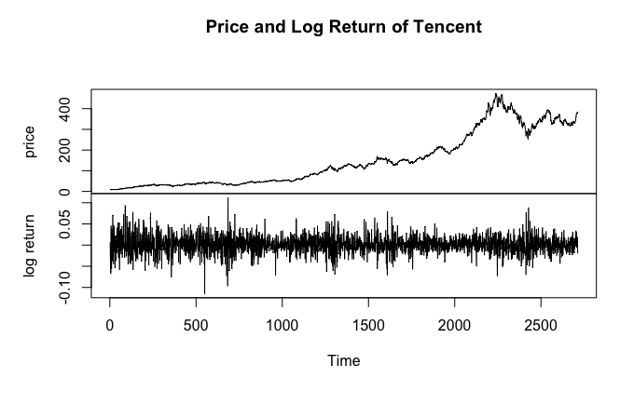
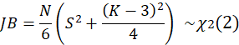
Detailed model construction idea part II
Restructure the idea(base on Tencent stock)
Transformations such as logarithms can help to stabilise the variance of a time series.(relog again)
Differencing can help stabilise the mean of a time series by removing changes in the level of a time series, and therefore eliminating (or reducing) trend and seasonality.
Data transformation: Just take the log return
Since the data amount we‘ve collected is so huge, the skewness is so close to 0, we don’t need to do box-cox transformation
Skewness: 0.03097989 close to 0
Kurtosis: 4.920543 > 3 but in an acceptable range
Test the normality
If doesn’t fit, replace the normal distribution in the formula by a suitably chosen student t-distribution.
Then try to consider applying ARCH and GARCH models
Test the normality by using the JB test
25
25

Slide 26
Detailed model construction idea part II
Restructure the idea(base on Tencent stock)
Transformations such as logarithms can help to stabilise the variance of a time series.
Differencing can help stabilise the mean of a time series by removing changes in the level of a time series, and therefore eliminating (or reducing) trend and seasonality.
Mean log return: 0.001322536
Skewness: 0.03097989 close to 0
Kurtosis: 4.920543 > 3 but in an acceptable range
Test the normality by using the JB test
Title:
Jarque - Bera Normalality Test
Test Results:
STATISTIC:
X-squared: 418.8106
P VALUE:
Asymptotic p Value: < 2.2e-16
26
Don’t fit normal distribution
26

Slide 27
Detailed model construction idea part II
Restructure the idea(base on Tencent stock)
Mean log return: 0.001322536
Skewness: 0.03097989 close to 0
Kurtosis: 4.920543 > 3 but in an acceptable range
Test of independence and randomness
> Box.test (logreturn.ts, lag = 10, type = "Ljung")
Box-Ljung test
data: logreturn.ts
X-squared = 21.691, df = 10, p-value = 0.01676
H0: the time series are independent
P value = 0.01676 < 0.05
Reject H0
So the time series of the log return of Tencent is not random and independent
So we proceed to acf and pacf
27
27

Slide 28
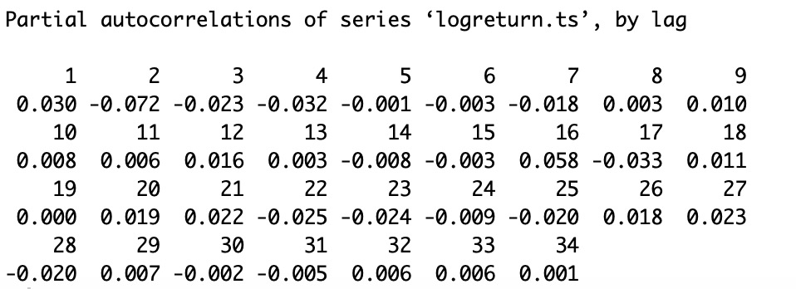
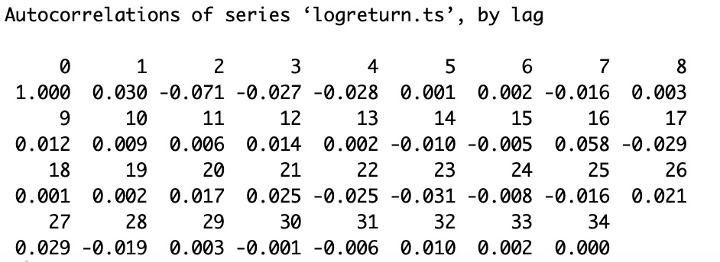
Detailed model construction idea part II
Restructure the idea(base on Tencent stock)
Candidate model: AR(1) OR ARMA(1,1)...
ARCH GARCH
28
28

Slide 29
Questions and reflection
Next week
Proceed to model selection and fitting:
After fitting, use AIC and BIC to determine which model is the best
And test the error term, whether it is white noise, if not, then reselect the model
Try consider and learn ARCH and GARCH model
How to choose the model in detail and be specific
Criteria of model selection
Error term testing
29
29

Slide 30
Supervisor: Dr. LCM Student: YIN, Zhendong
MATH 4999 Regular Meeting V

Slide 31
Detailed model construction idea & logic
Financial data analysis
Data choosing
Transformation method
Model selection
Based on acf and pacf
We observe the possible models candidates
Model fitting
Fitting each model to the data, check the effectiveness with AIC BIC AICc
Step by step, changing variables of the model one at each time
Residuals checking and testing
By checking residuals, in another word, whether the error term is white noise, to test the effectiveness of the model and by comparison, determine the best model
31
31

Slide 32
Detailed model construction idea & logic
Topic 1: Financial data analysis
3 options:
Price
Return
Log return
Difference between each: Stationarity
Weak stationarity（upper trend, seasonality）
Moderate stationarity
Strong stationarity
Return = (Pt-Pt-1)/Pt-1
Log return = ln(Pt/Pt-1)
32
32

Slide 33
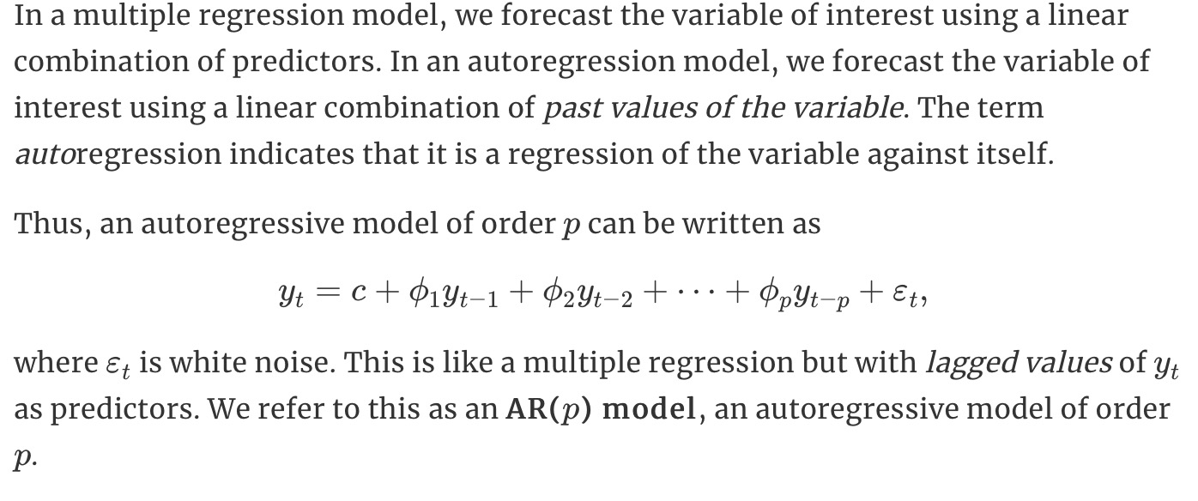
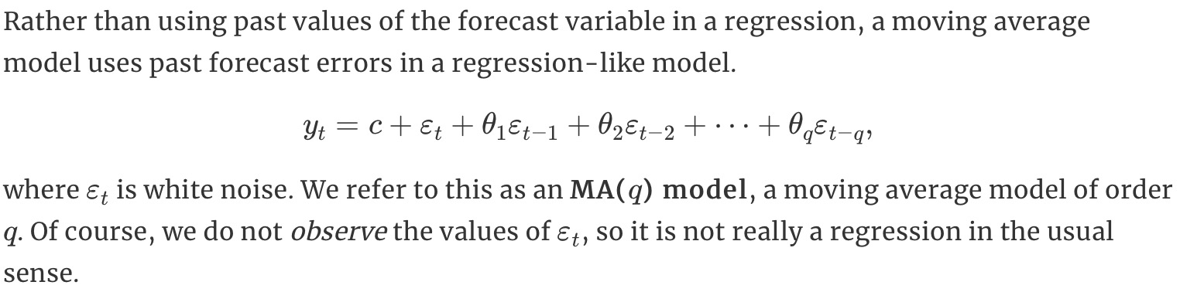
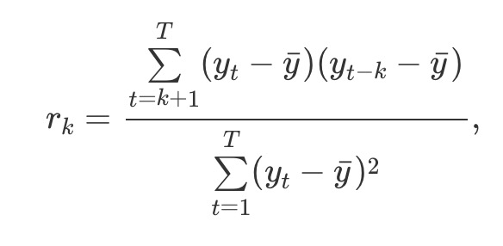
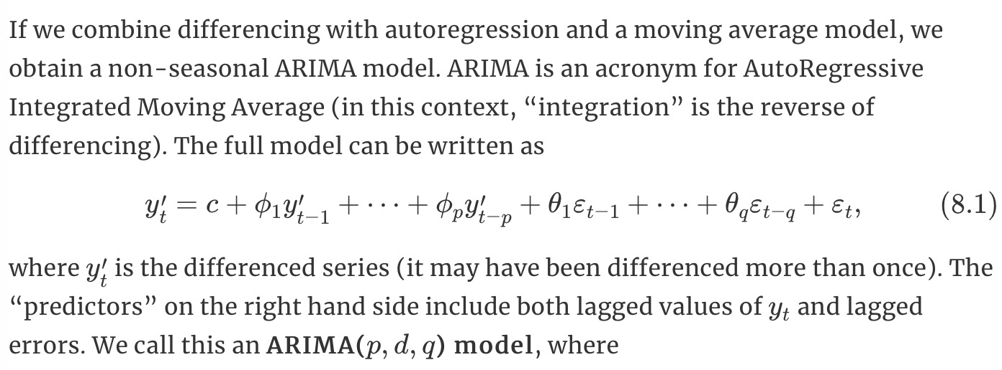
Detailed model construction idea & logic
Topic 2 : Model selection
AR
MA
ARMA
ARIMA
Reference: ACF & PACF
PACF: is the partial correlation coefficient between xt and xt−h adjusted for xt−1,...,xt−h+1. It does not depend on t and is denoted by ρh·1,...,h−1.
33
33

Slide 34
Detailed model construction idea & logic
Topic 2 : Model selection
AR
MA
ARMA
ARIMA
Determine MA(q)
Determine AR(p)
Reference: ACF & PACF
Candidates :
ARMA(1,1) also can be expressed by ARIMA(1,0,1)
ARIMA(2,0,1)
ARIMA(1,0,0)
ARIMA(2,0,2)
......
ACF:
PACF: is the partial correlation coefficient between xt and xt−h adjusted for xt−1,...,xt−h+1. It does not depend on t and is denoted by ρh·1,...,h−1.
Formalize the idea of the acf & pacf, expectation of the model why?
Make comparison and mention, detailed explanation
34
34

Slide 35
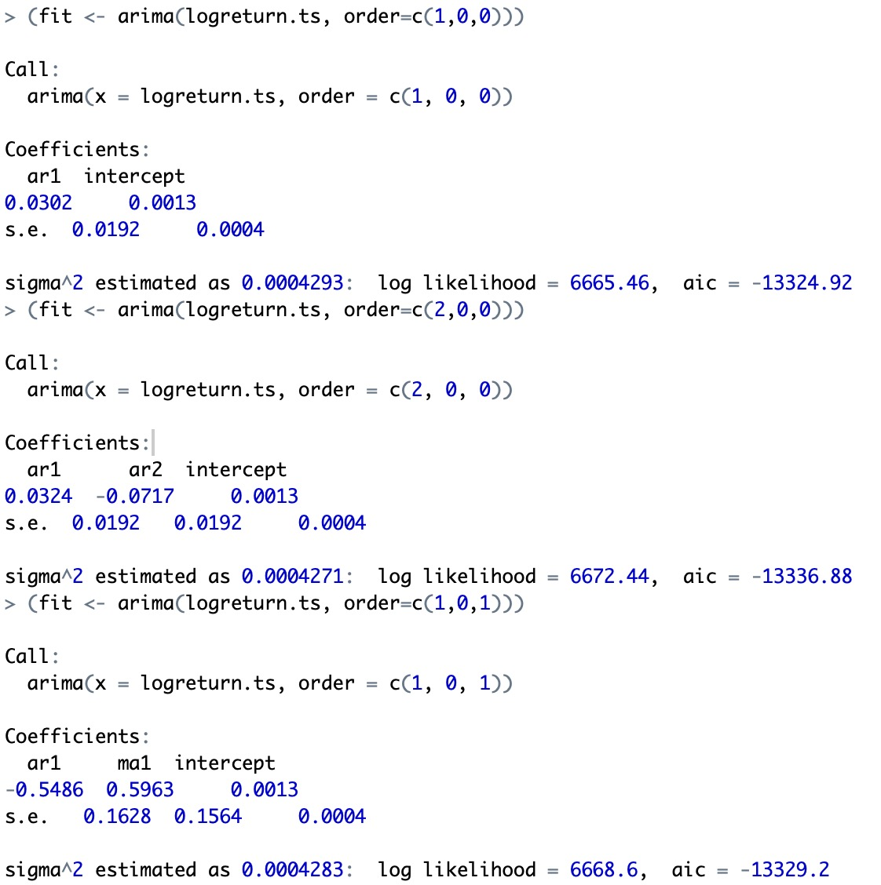
Detailed model construction idea & logic
Topic 3: Model fitting
AR
MA
ARMA
ARIMA
Reference: ACF & PACF
ACF:
PACF: is the partial correlation coefficient between xt and xt−h adjusted for xt−1,...,xt−h+1. It does not depend on t and is denoted by ρh·1,...,h−1.
35
35

Slide 36
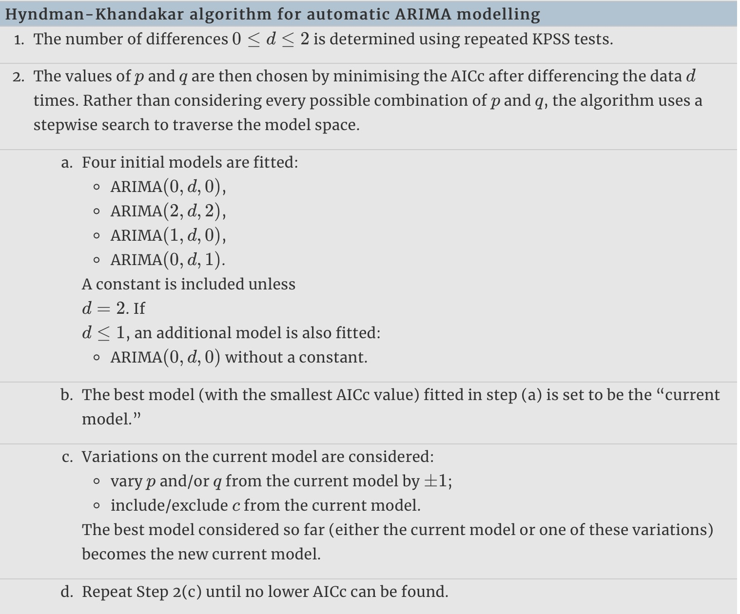
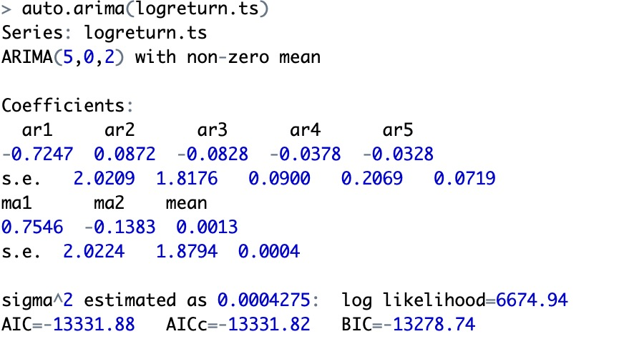
Detailed model construction idea & logic
Topic 3: Model fitting
Reference:
Auto.arima
AR
MA
ARMA
ARIMA: ”I” means the integrated/difference of the time series
Reference: ACF & PACF
ACF:
PACF: is the partial correlation coefficient between xt and xt−h adjusted for xt−1,...,xt−h+1. It does not depend on t and is denoted by ρh·1,...,h−1.
Why we choose the AIC?
36
36

Slide 37
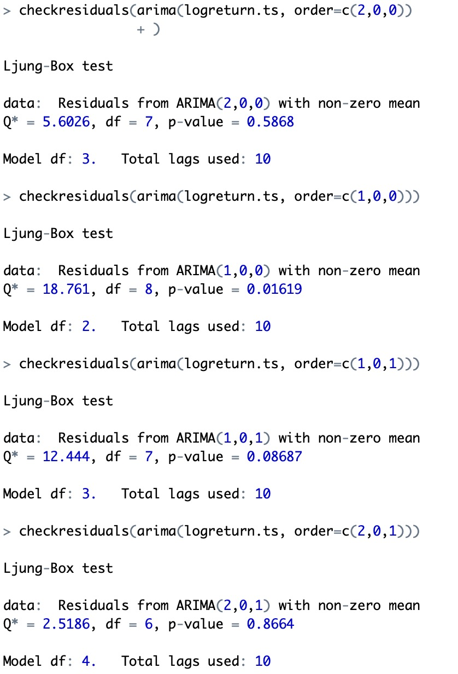
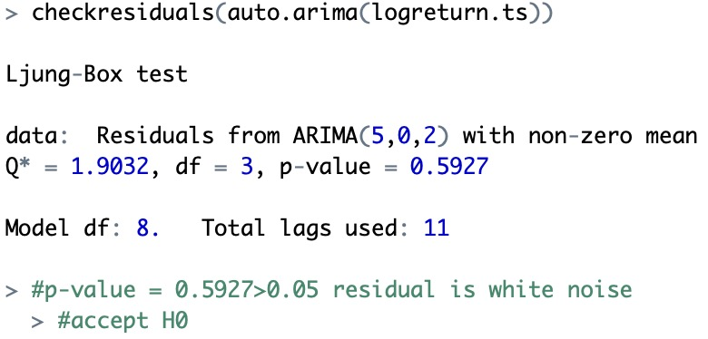
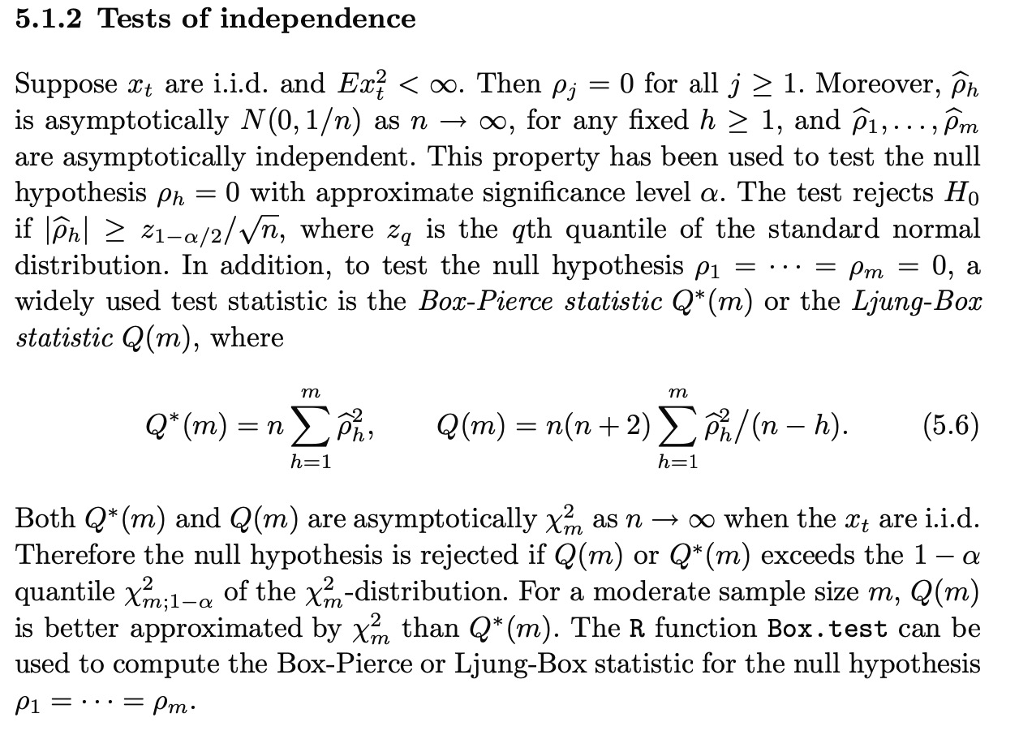
Detailed model construction idea & logic
Topic 4: Residuals checking and testing
Ljung box test
White noise check

Slide 38
Detailed model construction idea & logic
Topic 4: Residuals checking and testing
Ljung box test
White noise

Slide 39
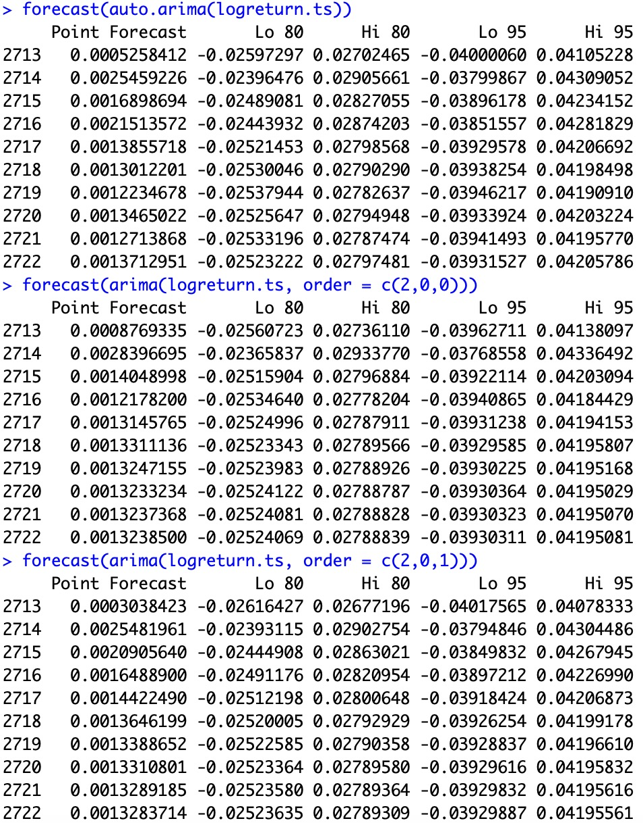
Detailed model construction idea & logic
Topic 4: Residuals checking and testing
Three best models
ARIMA(2,0,0)
ARIMA(2,0,1)
ARIMA(5,0,2)
Ljung box test
White noise
More sample to try(acf,pacf)
T-distribution
Make comparison with other market
Fitting testing

Slide 40
Supervisor: Dr. LCM Student: YIN, Zhendong
MATH 4999 Regular Meeting VI

Slide 41
Review of the last part
In previous findings, we raise tencent stock as an example, while we compare different types of data (Price, return, log return), analyzing the differences, pros and cons, and the fundamentals of choosing log return.
The time series model we‘ve fitted turns out to be ARMA(5,2). And we check the residuals to test the model effectiveness.
So I proceed to the next stage. To research into more examples.
So I start from banking industry.
But that’s when the problem arises.
> summary(auto.arima(logr2.ts))
Series: logr2.ts
ARIMA(1,0,1) with zero mean
Coefficients:
ar1 ma1
0.8055 -0.8497
s.e. 0.0924 0.0828
sigma^2 estimated as 7.289e-05: log likelihood=8492.36
AIC=-16978.72 AICc=-16978.71 BIC=-16961.2
41
41

Slide 42
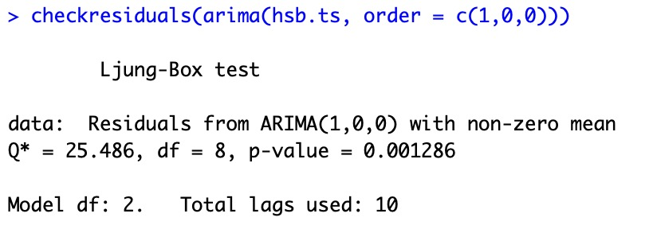
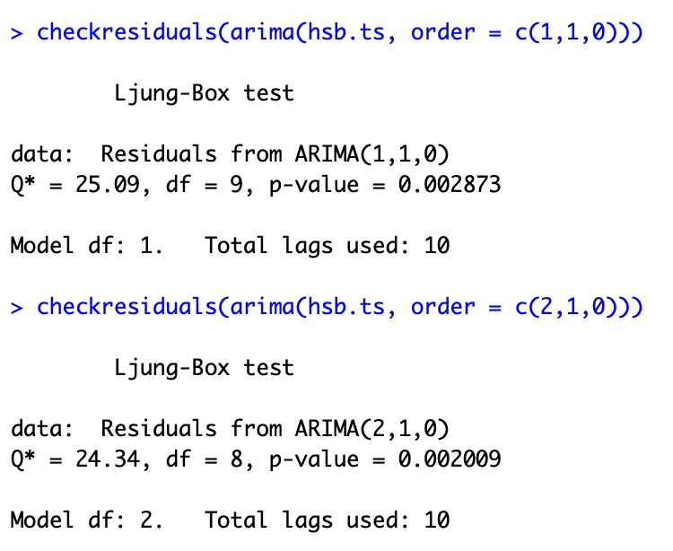
Problem
The banking industry on HSI can be extremely mediocre.
Both the price and the return are low volatile.
So I try to fit certain time series model to it, first analyzing on the stock price.
But the outcomes are not satisfying. So I first test the price.
42
42

Slide 43
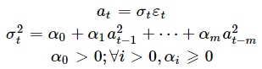
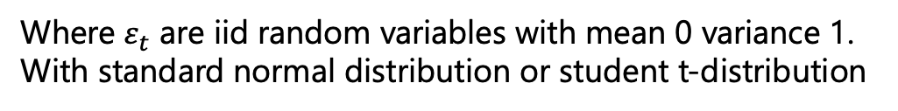
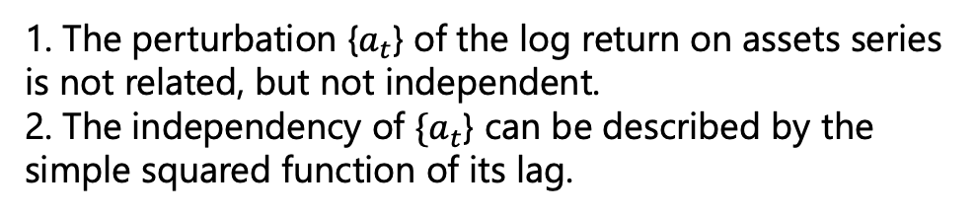
ARCH-GARCH
While at the same time, the log return turns out to be a white noise. So we have to find better analyzing angle.
So I research into the volatility of the price and log return, trying to figure out the characters and properties of the new time series.
Time series model for the volatility should be ARCH & GARCH
Model.
1. The perturbation {$a_{t}$} of the log return on assets series is not related, but not independent.
2. The independency of ${\{a}_{t}$} can be described by the simple squared function of its lag.
Where $ε_{t}$ are iid random variables with mean 0 variance 1.
With standard normal distribution or student t-distribution
43
43

Slide 44
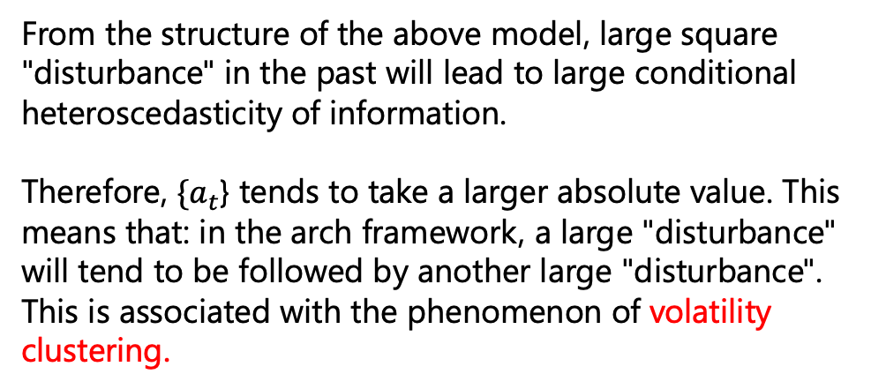
ARCH-GARCH construction
From the structure of the above model, large square "disturbance" in the past will lead to large conditional heteroscedasticity of information.
Therefore, ${\{a}_{t}$} tends to take a larger absolute value. This means that: in the arch framework, a large "disturbance" will tend to be followed by another large "disturbance". This is associated with the phenomenon of volatility clustering.
Mean equation such as AR model is like some linear equations of the time series, which just generalize the basic trend.
Step (1): establish a mean equation by testing the serial correlation of the data, and if necessary, establish a time series model (such as ARMA) for the yield series to eliminate any linear dependence.
Step (2): test the ARCH effect on the residual of the mean equation
Step (3): if there is ARCH effect, the volatility model is established
Step (4): verify the fitted model and optimize it if necessary
Option price & volatility propotional
So for this ARCH analysis the outcomes we would derive would be a ARMA model on the log return + an ARCH model on the volatility
44
44

Slide 45
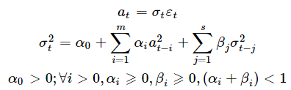
ARCH-GARCH construction
Although ARCH model is simple, in order to fully describe the volatility process of yield, lots of parameters are needed. Sometimes, there would be ARCH(m) model with large m. Therefore, Bollerslev (1986) proposed a generalized ARCH model (GARCH)
AR(7) or AR(9)
It is similar to the previous arch model, but it is difficult to determine the order of GARCH (m, s). Generally, low order models are used, such as GARCH (1,1), GARCH (2,1), GARCH (1,2), etc.
Back testing and more test criteria to prove the advantages
ARCH(5)
45
45

Slide 46

ACF & PACF Selection criteria

Slide 47
Banking industry

Slide 48
Thinking about the trading strategy
Investment goal
Objective: certain return, downside loss 回撤, sharpe ratio
Finish arch and garch
More industries model fitting
Comparison, comprehensive analysis
brainstorm the trading strategy

Slide 49
Supervisor: Dr. LCM Student: YIN, Zhendong
MATH 4999 Regular Meeting VII

Slide 50
Review and Overview
In previous findings, we raise banking industry on HSI as examples, and fit certain ordinary model to it
But the outcomes turn out to abnormal, indicating that ARIMA model only cannot fit exactly to the performance of the low volatility or even uncorrelated return of the banking stocks.
So we try out advance models such as ARCH and GARCH model. The main ideas of these advance models are to generalize the patterns of the volatility, but the modification effect on the log return is unknown.
So the first part of the today’s report is to check whether the ARCH and GARCH model would have better interpretation on the return to make better forecast.
And the second part is to analyze on the stock selection based on the model outcomes.
In the third part, we would brainstorm about the strategy.
50
50

Slide 51
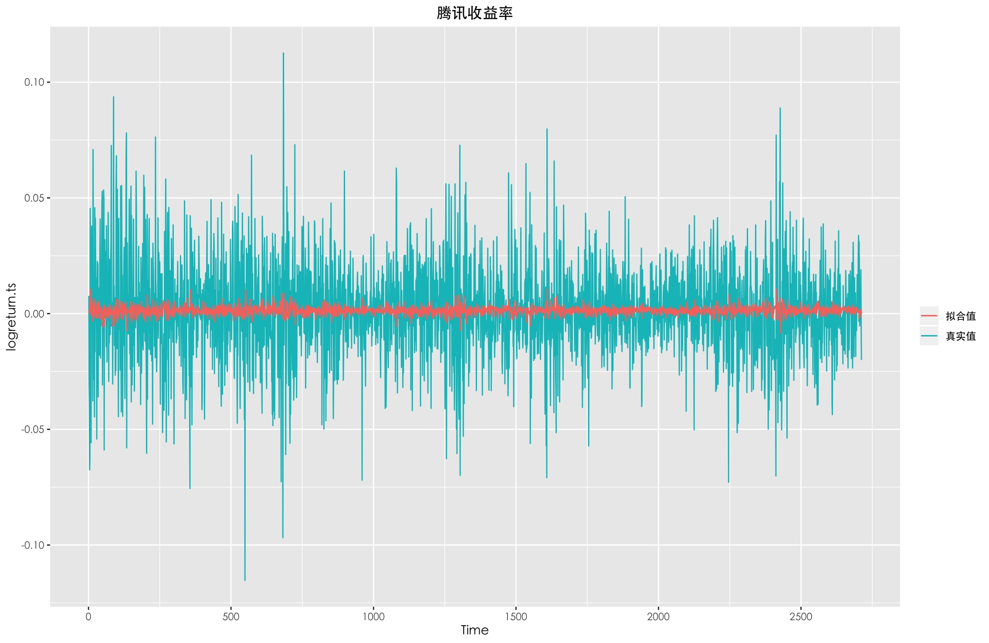
Part I: ARCH and GARCH
> ArchTest(residuals(auto.arima(logreturn.ts)))
ARCH LM-test; Null hypothesis: no ARCH effects
data: residuals(auto.arima(logreturn.ts))
Chi-squared = 145.28, df = 12, p-value < 2.2e-16
Reject null hypothesis. There is arch effect.
Perform Lagrange Multiplier test for the null hypothesis that the residuals of a ARIMA model are homoscedastic.
Homoscedastic: In statistics, a sequence of random variables is homoscedastic if all its random variables have the same finite variance. This is also known as homogeneity of variance. The complementary notion is called heteroscedasticity.
One type of test proposed by Engle (1982) is the Lagrange Multiplier test which is to fit a linear regression model for the squared residuals and examine whether the fitted model is significant. So the null hypothesis is that the squared residuals are a sequence of white noise, namely, the residuals are homoscedastic.
51
51

Slide 52
Part I: ARCH and GARCH
> summary(r_garch)
Call:
garch(x = residuals(auto.arima(logreturn.ts)), order = c(2, 1), reltol = 1e-06)
Model:
GARCH(2,1)
Residuals:
Min 1Q Median 3Q Max
-5.1739460 -0.5997678 -0.0005292 0.6023536 4.1714525
Coefficient(s):
Estimate Std. Error t value Pr(>|t|)
a0 1.731e-05 3.268e-06 5.298 1.17e-07 ***
a1 1.122e-01 1.564e-02 7.177 7.15e-13 ***
b1 3.713e-01 1.119e-01 3.319 0.000902 ***
b2 4.765e-01 1.009e-01 4.724 2.31e-06 ***
---
Signif. codes: 0 ‘***’ 0.001 ‘**’ 0.01 ‘*’ 0.05 ‘.’ 0.1 ‘ ’ 1
Diagnostic Tests:
Jarque Bera Test
data: Residuals
X-squared = 156.94, df = 2, p-value < 2.2e-16
Box-Ljung test
data: Squared.Residuals
X-squared = 0.4945, df = 1, p-value = 0.4819
Volatility of the logreturn
Volatility fitted by GARCH(2,1) on the residuals of ARMA(5,2)
52
52

Slide 53
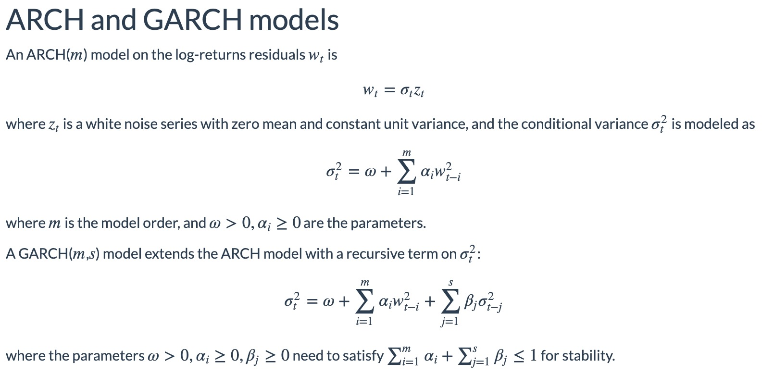
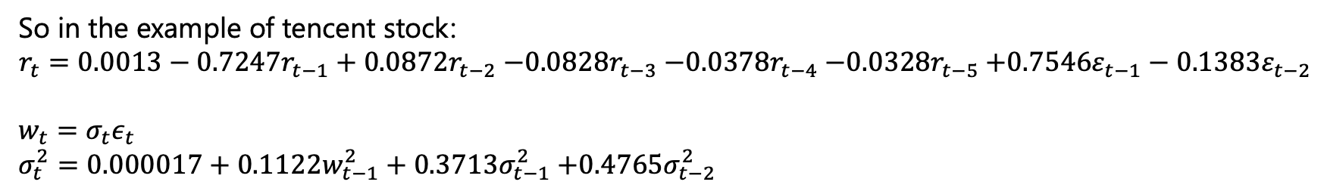
Part I: ARCH and GARCH
So in the example of tencent stock:
$$r_{t}={0.0013−0.7247r}_{t−1}+{0.0872r}_{t−2}{−0.0828r}_{t−3}{−0.0378r}_{t−4}{−0.0328r}_{t−5}{+0.7546ε}_{t−1}−{0.1383ε}_{t−2}$$
$$w_{t}=σ_{t}ε_{t} \\ σ_{t}^{2}=0.000017+{0.1122w}_{t−1}^{2}+{0.3713σ}_{t−1}^{2}{+0.4765σ}_{t−2}^{2}$$
53
53

Slide 54
Part II: Stock selection
Having fitted model on more than 50 stocks, based on their historical performance from 2009 to 2019.
(would be shown in another file)
1.What’s the selection criteria?
2. Some tech stocks are not included since the lack of historical data during 2009-2019, how we analyze them?
54
54

Slide 55
Part III: Trading strategy
Initial idea:
The idea of the strategy is relatively simple
The strategy is carried out on a "rolling" basis:
For each day, n, since we have fitted an optimal ARIMA and GARCH model based on historical performances.
The combined model is used to make a prediction for the next day returns.
If the prediction is negative the stock is shorted at the previous close, while if it is positive it is longed.
If the prediction is the same direction as the previous day then nothing is changed.
Back-testing and simulation should be performed
55
55

Slide 56
Problems and reflection
The ARIMA-GARCH fit would provide a clearer horizon of the future performance, both return and volatility included.
Then our trading strategy should be developed based on the model prediction.
Size of our portfolio?
How to connect portfolio optimization with trading strategy?
56
56

